Slide 1
Map Reduce

Slide 2
Hadoop MapReduce Model
The MapReduce computation model provides a very powerful tool for big data applications.
Its underlying idea is very simple.
There are two stages: a mapping stage and a reducing stage.
In the mapping stage, a mapping procedure is applied to input
data.
– For instance, assume you need to count how many times each word appears in the novel. One solution is to gather 20 people and give them each a section of the book to search. This step is
the map stage.

Slide 3
Reduce Stage Example
In the reducing stage, the results from the mapping stage are aggregated and combined.
Example: After the 20 people count how many times each word appears in their assigned sections (the map stage), they now bring their results together.
The results from all sections are combined to produce a final word count for the entire novel.
This step ensures that the counts from different sections are summed up correctly.

Slide 4
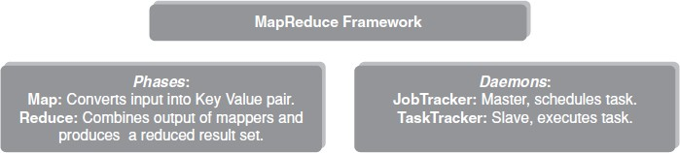
What is MapReduce Programming?
MapReduce Programming is a software framework.
It helps to process massive amounts of data in parallel.

Slide 5
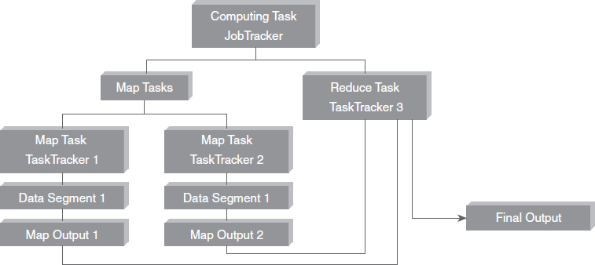
How MapReduce Programming Works

Slide 6
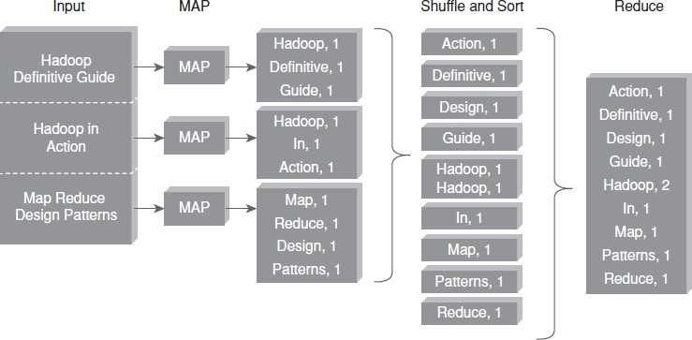
MapReduce – Word Count Example

Slide 7
MapReduce Word Count Example – Input Stage
The input consists of multiple documents, such as :
“Hadoop Definitive Guide”
“Hadoop in Action”
“Map Reduce Design Patterns”
Each document is split into words, which will be processed individually.

Slide 8
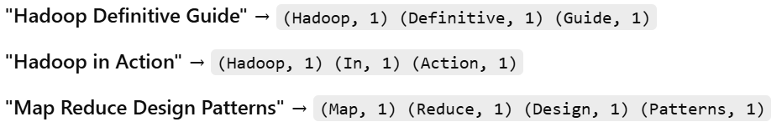
MapReduce Word Count Example – Map Stage
Each document is processed by a Mapper function, which breaks sentences into words and assigns each word a count of 1.
Example outputs from the Map function :

Slide 9
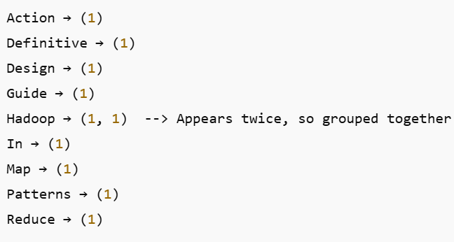
MapReduce Word Count Example – Shuffle and Sort Stage
All (word, count) pairs generated by the Mappers are collected, grouped, and sorted before passing them to the Reducer.
Words are grouped together based on their key (word), so all occurrences of the same word are brought together:

Slide 10
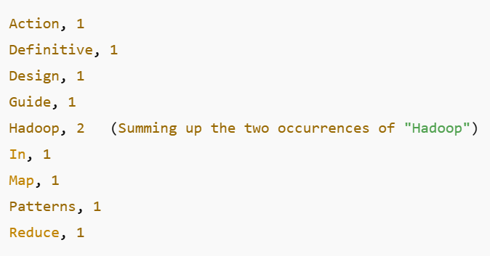
MapReduce Word Count Example – Reduce Stage
The Reducer aggregates the counts for each word.
The final output is a word-frequency count for the entire dataset.

Slide 11
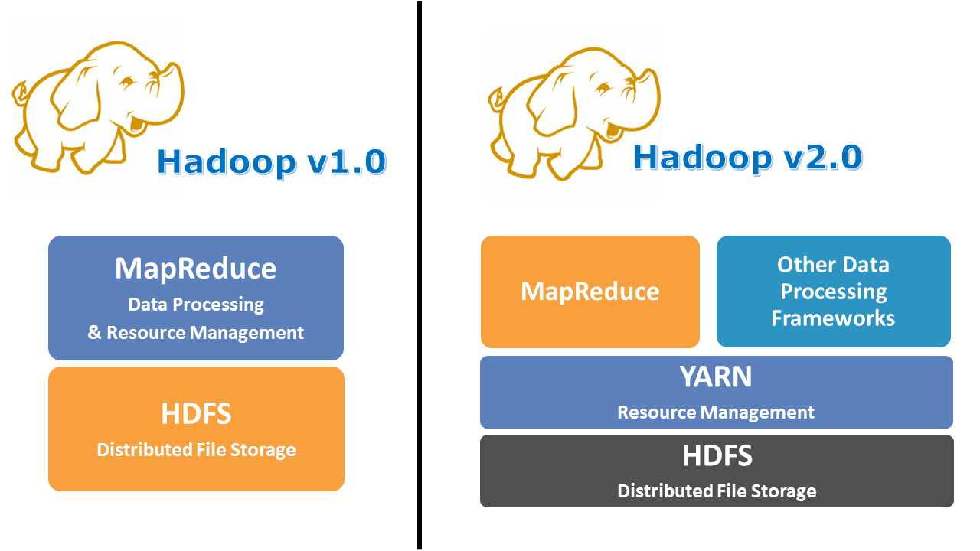

Slide 12
Limitations of Hadoop 1.0 Architecture
Single NameNode is responsible for managing entire namespace for Hadoop Cluster.
It has a restricted processing model which is suitable for batch-oriented MapReduce jobs.
Hadoop MapReduce is not suitable for interactive analysis.
4. Hadoop 1.0 is not suitable for
machine algorithms, graphs, and other memory
learning intensive
algorithms.

Slide 13
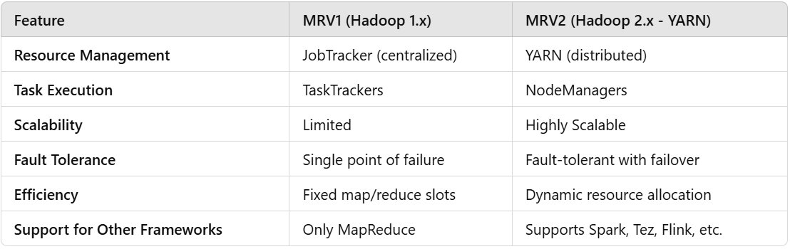
Difference between MRV1 and MRV2

